Slide 1
OU Online Conference 2022
Clarissa Anderson, Office of Digital Learning
Inclusive Online Teaching:
Incorporating Universal Design for Learning and Accessibility

Slide 2
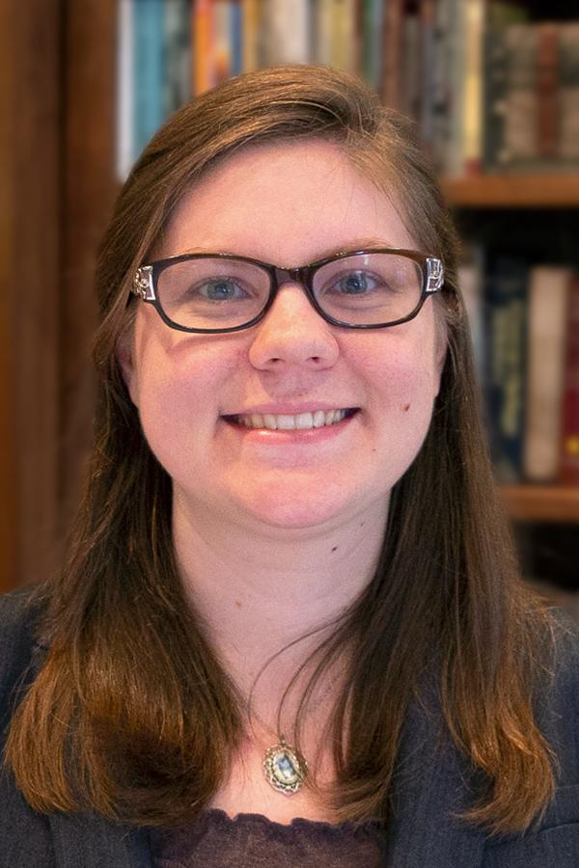
About Me
Worked with ODL since 2018
One of ODL’s accessibility experts
Bachelor’s in Journalism New Media from Baylor University
Instructional Designer Certificate Program, Online Learning Consortium (OLC)
Master’s degree candidate in Learning Design and Technology from George Mason University
Clarissa Anderson
Course Developer

Slide 3
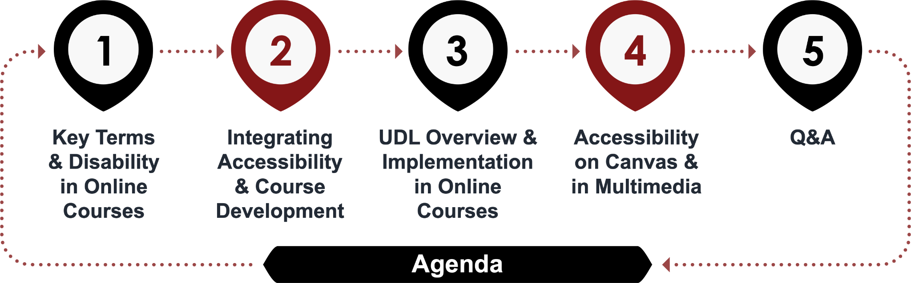
About This Session

Slide 4
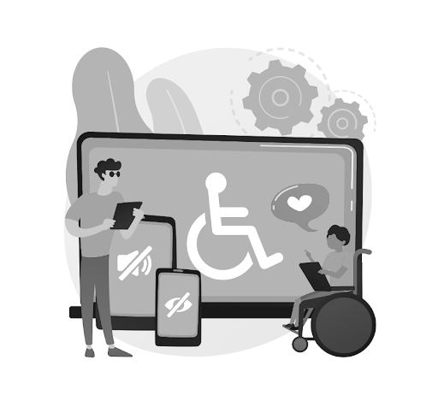
Getting Help on Accessibility/UDL
Contact ODL if you have general questions about accessibility
  ODL can provide suggestions or refer you to ADRC or OU Libraries if an expert is needed
See resources & references for more on accessibility/UDL

Slide 5
Key Terms

Slide 6




Key Terms
Student-centered Learning
Considering the students’ learning needs when
creating a course
Accessibility
Ensuring all users have equal access
to content and services
Usability
Designing an effective,
efficient, and inclusive learner experience
Accommodations
Adapting a course or materials to meet an individual’s specific needs
Notes:
Student-centered learning, then, occurs when course design is usable, readable, and accessible. It means considering students’ learning needs when designing a course and requires both purposeful design and evaluation. And now, we will delve deeper into these topics, starting with usability.

Slide 7
Disability & Online Courses

Slide 8
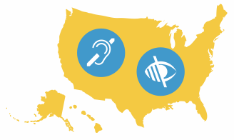
Prevalence of Disability in U.S. Adults
61 million adults have some type of disability
Equal to 1 in 4 people in the U.S. adult population
Source: CDC (2020)

Slide 9
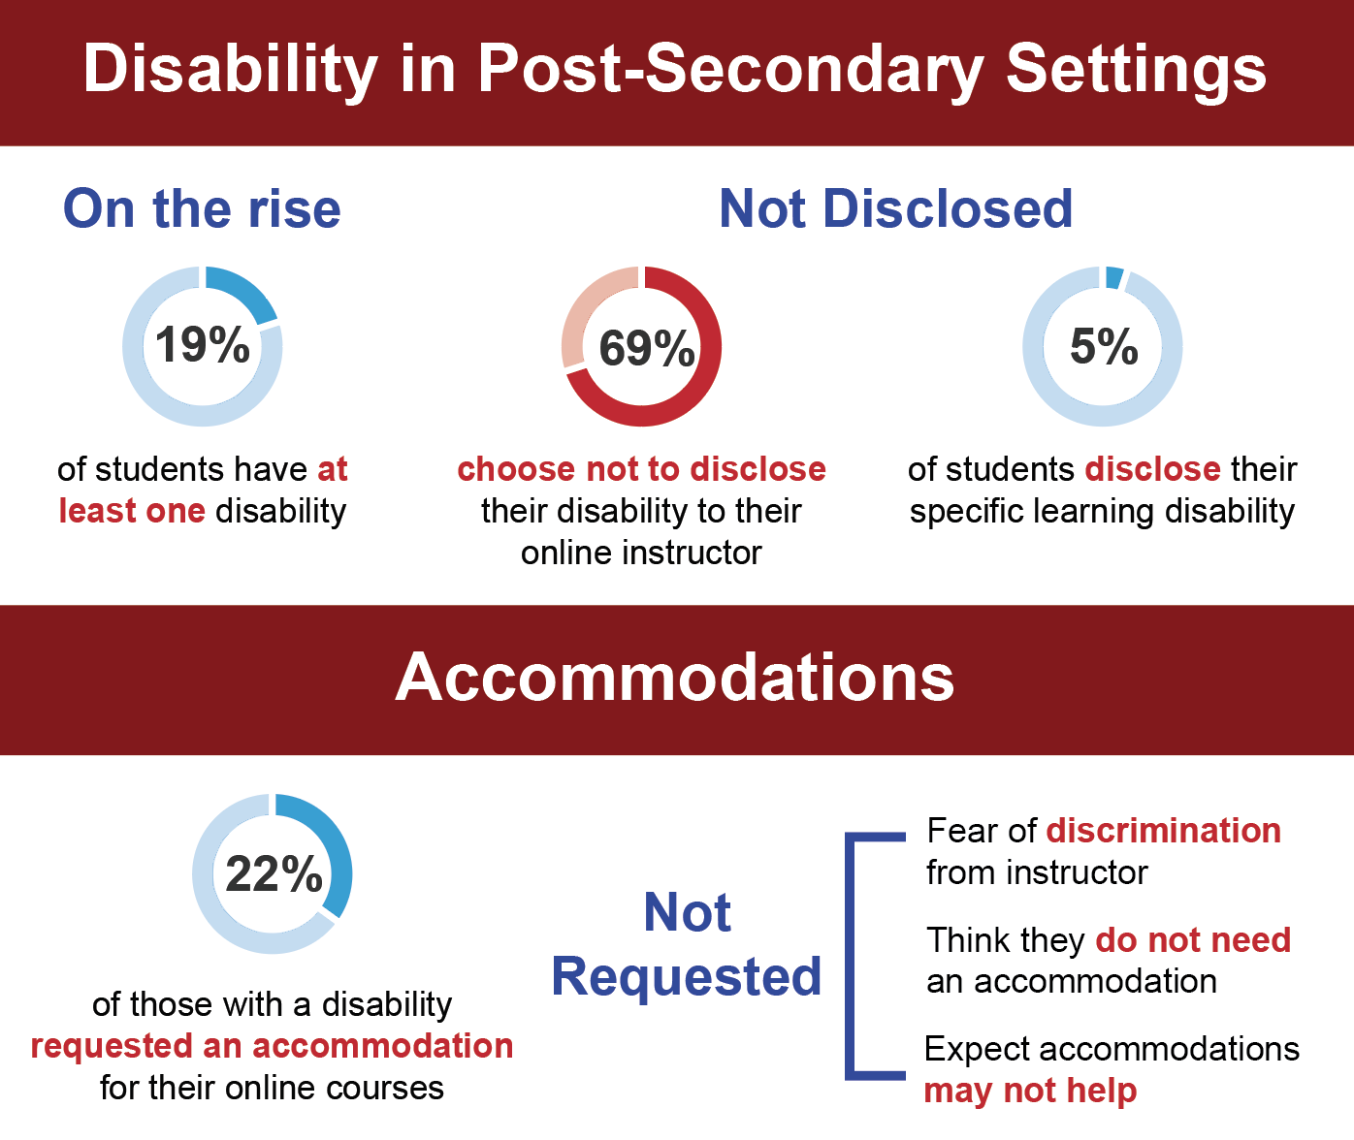
Disability in Post-Secondary Settings
Sources: Burgstahler (2021); National Center for Learning Disabilities (n.d.); National Center for Education Statistics (2021); Roberts, J. B., et al (2011).

Slide 10
Accommodations in Online Courses
Sources: Burgstahler (2021); National Center for Learning Disabilities (n.d.); National Center for Education Statistics (2021); Roberts, J. B., et al (2011).

Slide 11
Approaches to Accessibility
Medical Model
Social Model
Reactionary
Focus on student’s perceived ‘deficit’
Student must disclose disability
Accommodations first
Proactive
Focus on barriers in the learning environment
Reach as many students as possible
Utilizes UDL
Sources: Burgstahler (2017) & (2021), Seale (2020), Singleton et al (2019), and Mole (2013)

Slide 12
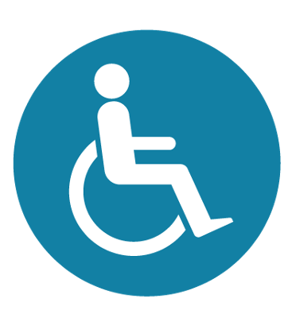
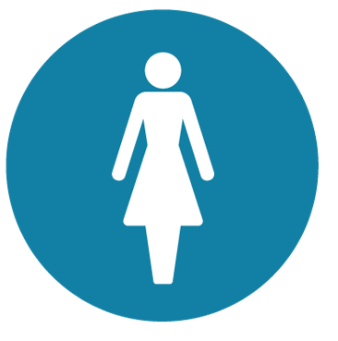
Types of Disabilities
Visible
Invisible
In the online environment, all disabilities are invisible disabilities
Visual
Auditory
Mobility
Chronic illness
Mental illness
Learning disability

Slide 13





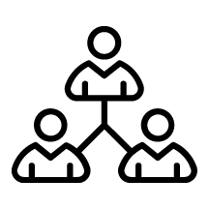
Facts on Accessibility
Helps all users
Easy to learn and implement
Required by law
Doesn’t change development time when a habit
Don’t wait for an accommodation to be requested to start
Everyone has a role in accessibility

Slide 14
Laws & Guidelines
ADA Title II
ADA Title III
Prohibits discrimination on basis of disability in all public entities, including universities
Websites can be considered places of public accommodation
Section 508
Web Content Accessibility Guidelines (WCAG)
Sets requirements for accessible technology
International standards for web accessibility

Slide 15





Implications of Complaints and Lawsuits
Library resources, department websites, and course management systems should be accessible (Penn State, 2011)
Documents and course materials should be accessible, including classroom clickers (University of Montana, 2014)
Universities should follow WCAG 2.0 level AA standards (University of Phoenix, 2015)
Universities should caption all online resources, including videos hosted on third party platforms like YouTube (Harvard and MIT, 2015-2020)
Third party websites and software should be accessible, including Pearson MyMathLab (Maricopa Community College District, 2014 and LA Community College District, 2019)

Slide 16
Integrating Accessibility & Course Development

Slide 17

Common Issues Individuals with Disabilities
Encounter in Online Courses
Accessibility of:
  Canvas and websites
  Audio and video content
  Course documents (PPT, PDF, DOC, XLS, etc.)
Inflexible time limits on quizzes and exams
Lack of access to assistive technology
Source: Kent (2015)

Slide 18




Action Plan: Designing for Accessibility
Plan
for accessibility and UDL from the beginning
Incorporate
inclusive assessments and materials
Utilize
automated accessibility checkers
Develop
plan B if an accommodation is needed
Source: AccessibleU (University of Minnesota): Accessibility for Instructors

Slide 19
Questions to Ask During Course Development
✓
How can I use technology in accessible ways?
✓
What accessibility challenges might be present in this course?
✓
Do my objectives and assessments consider UDL and accessibility?
✓
At what checkpoints will I confirm accessibility and UDL?
✓
If accommodations are needed, what must be done to provide them?
✓
Ultimately: Is my course accessible?

Slide 20
Universal Design & Universal Design for Learning

Slide 21
Discussion
What do you know about Universal Design? What about UDL? In what ways might the two concepts differ?
Notes:
Do you have any examples to provide?

Slide 22
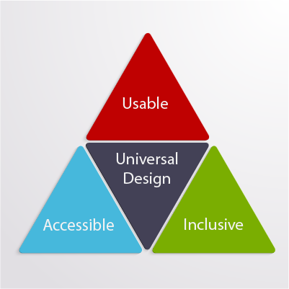
Defining Universal Design
Universal Design for Learning began with a principle called Universal Design
“[T]he design of products and environments to be usable to the greatest extent possible by people of all ages and abilities”
Source: Washington University DO-IT (2021)

Slide 23
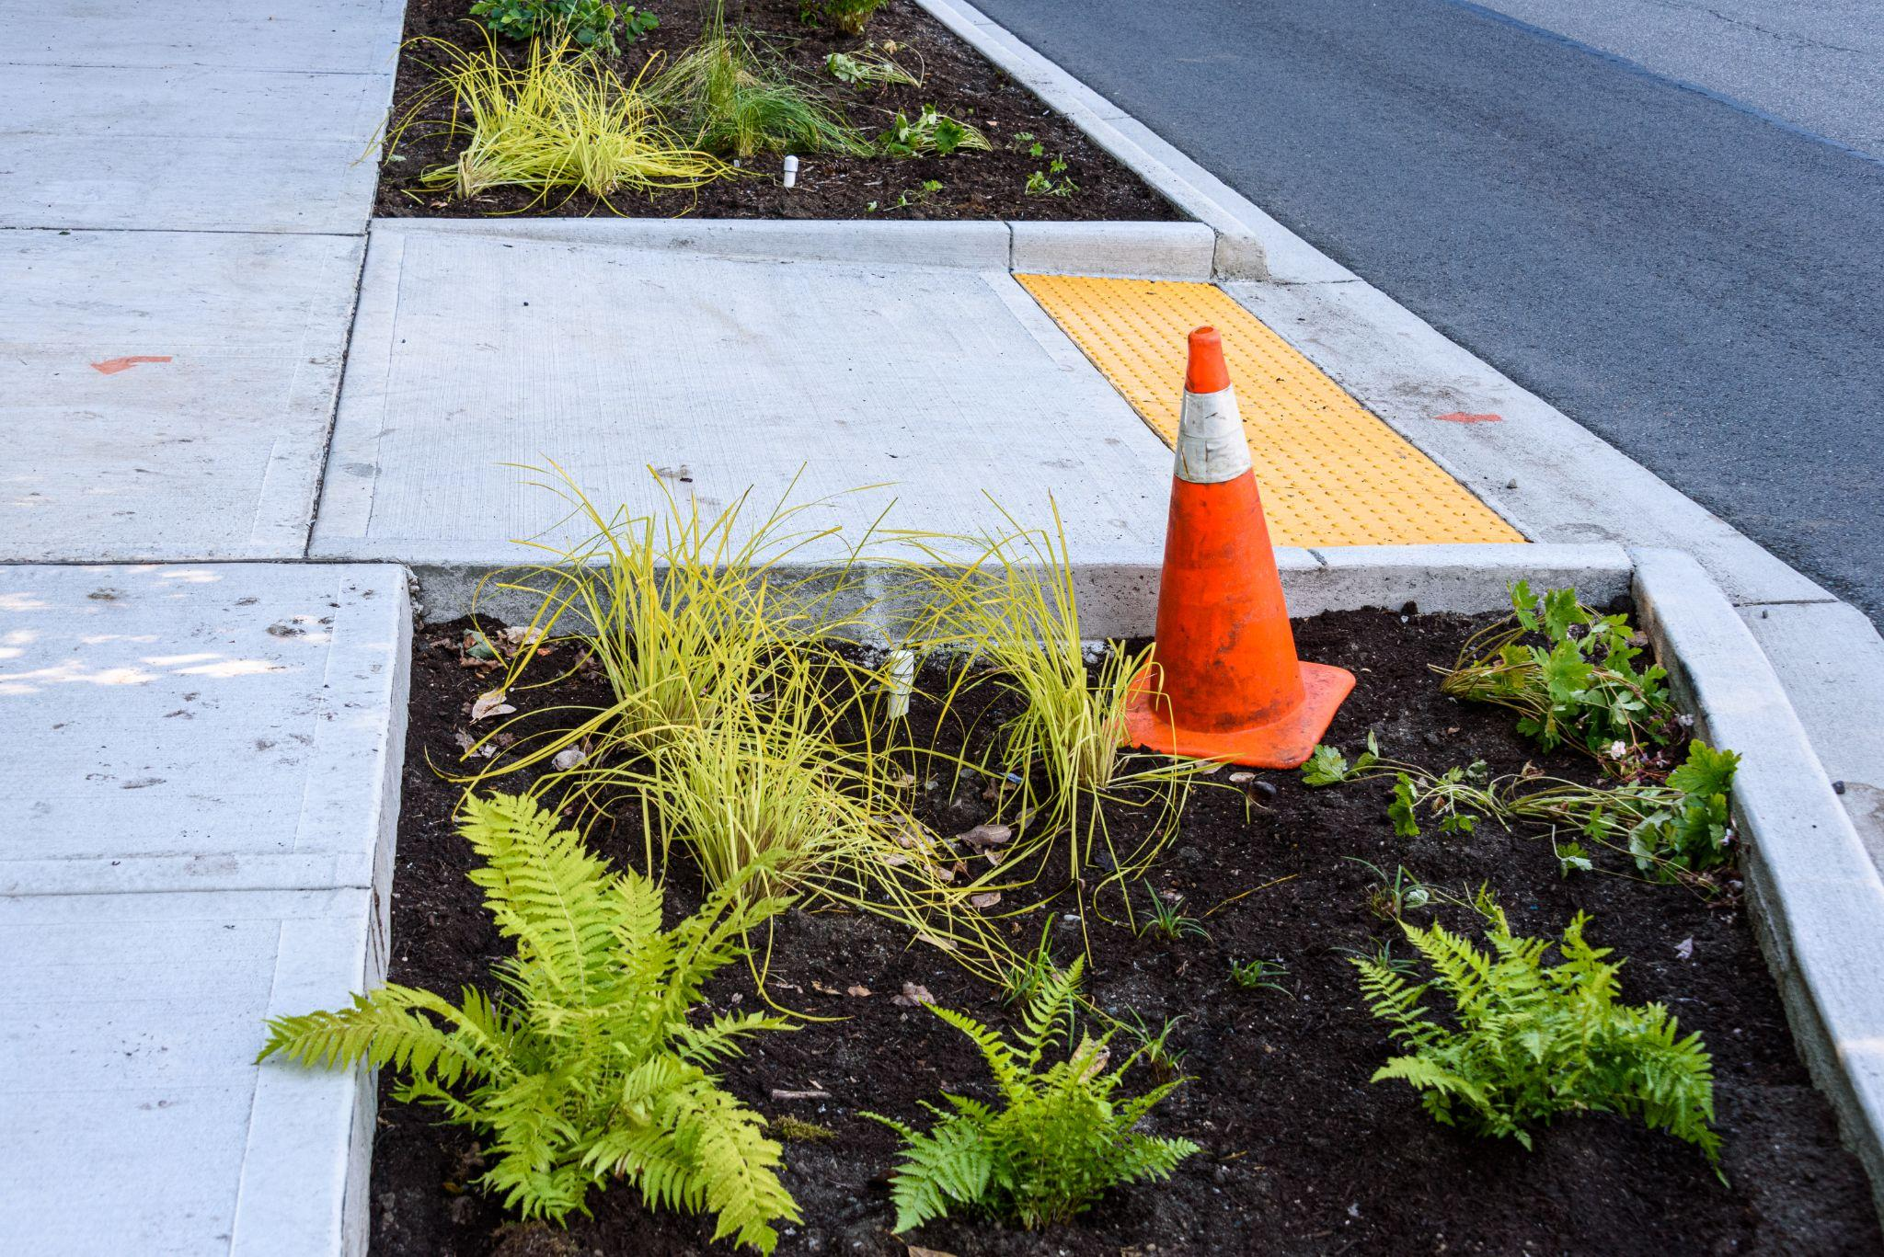
Universal Design Example: Curb Cuts
Benefits the following individuals:
  Using wheelchairs
  Using strollers or rolling suitcases
  Pushing shopping carts
  Using a walker or crutches
  Bringing a bike
Source: Nelson (2021)

Slide 24
Universal Design & Universal Design for Learning (UDL)
Universal Design | Universal Design for Learning (UDL)
Removing barriers in physical environment | Removing barriers in learning environment
Proactive design | Proactive design
Physical retrofitting is costly | Course retrofitting is time consuming and difficult to implement
Source: Sonoma State University UDL Faculty Guide

Slide 25
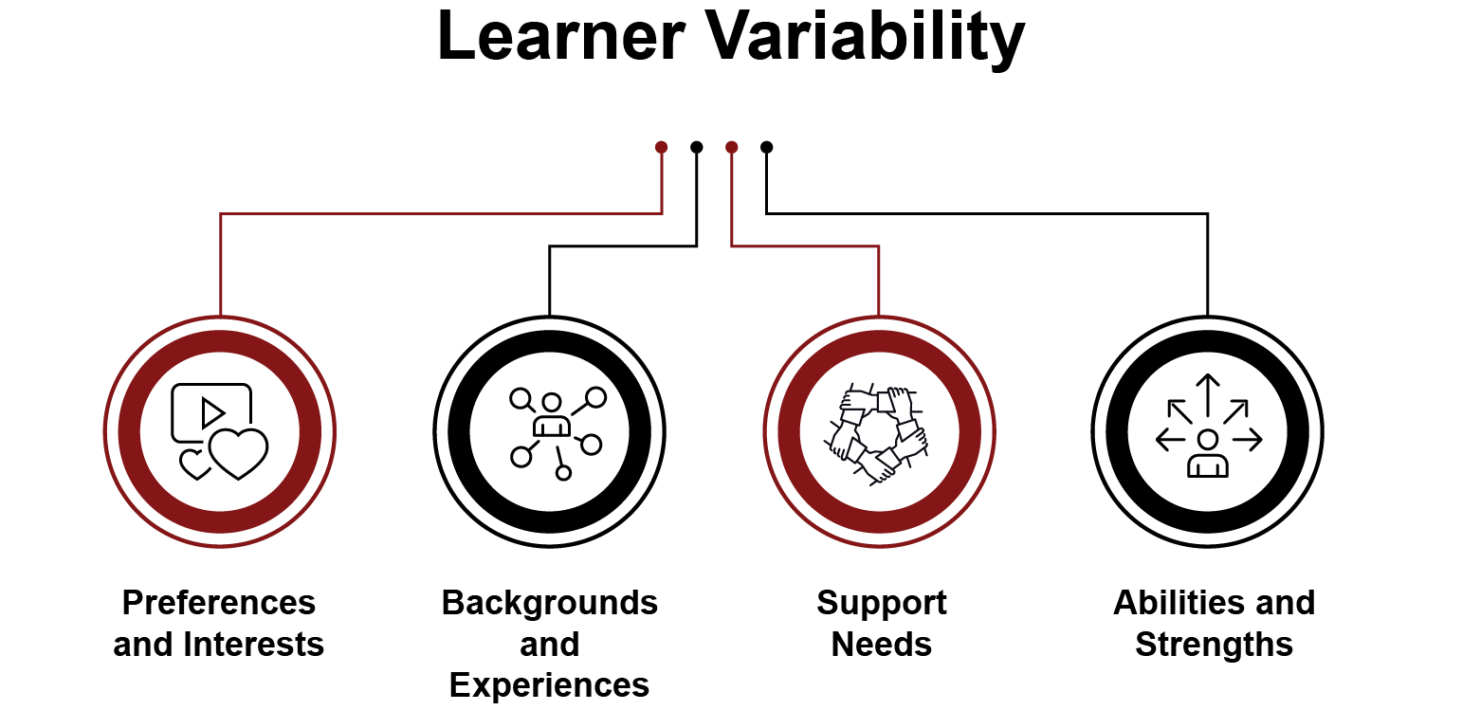
Defining Universal Design for Learning
“Consider the diverse needs and abilities of all throughout the design process”
National Disability Authority (Ireland)

Slide 26
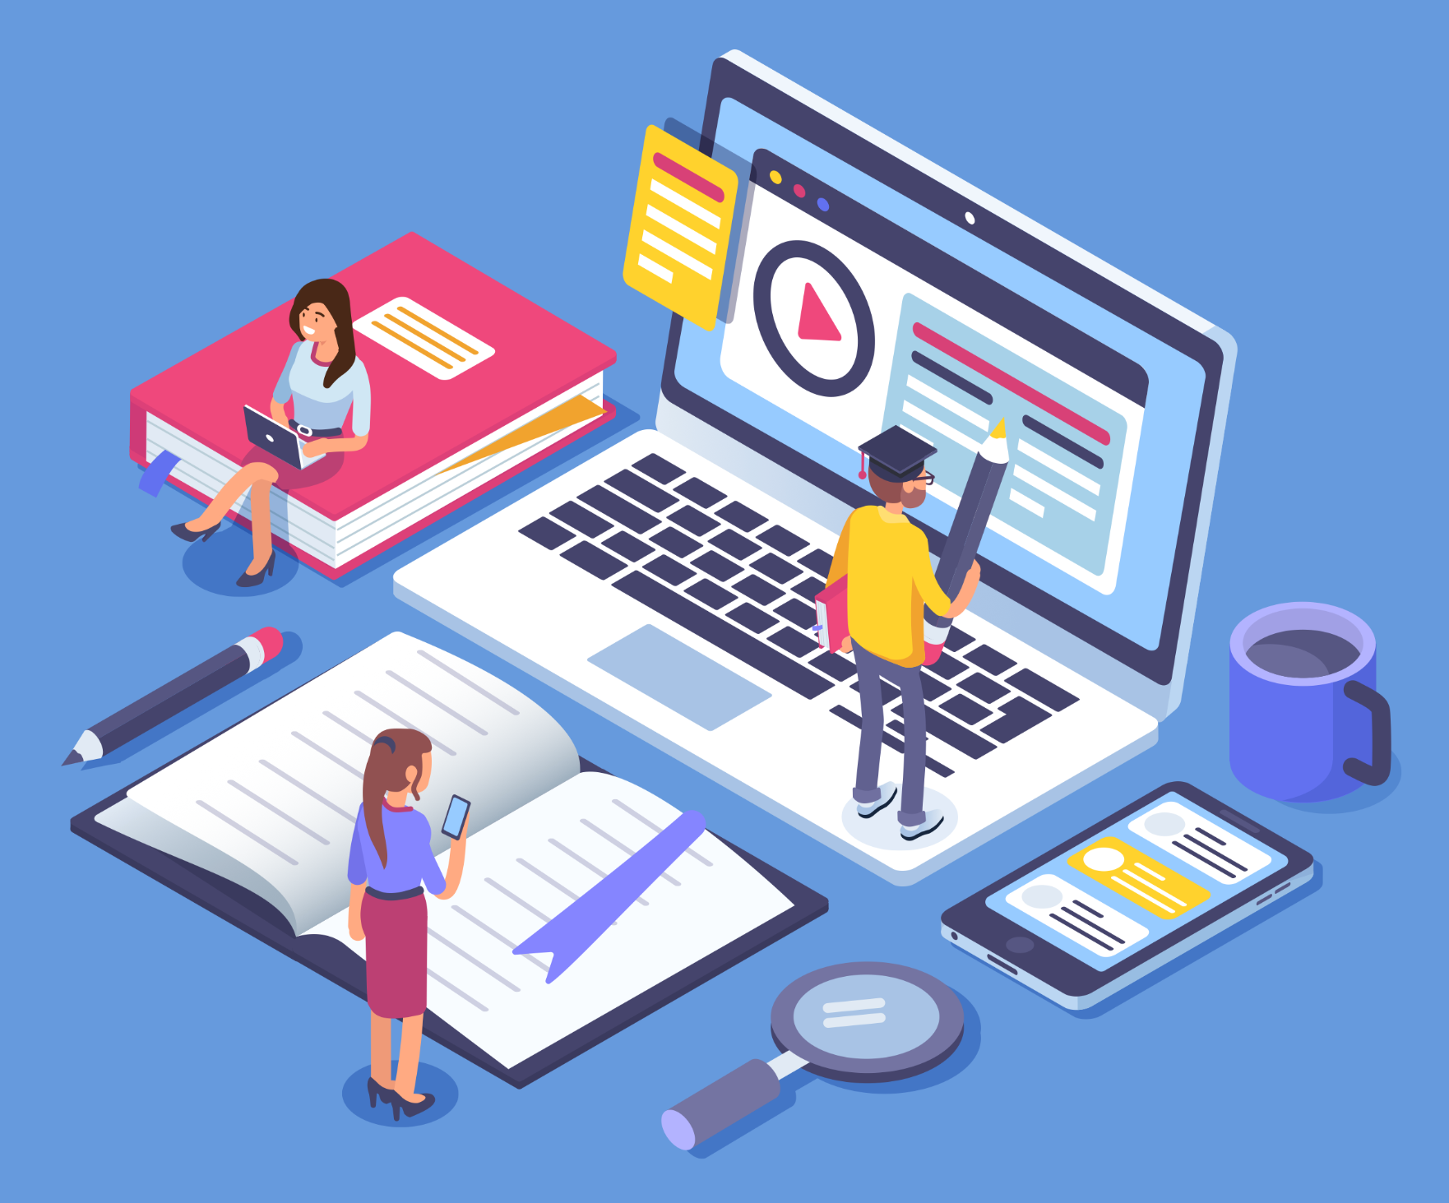
UDL Example: Captions
Benefits the following individuals:
  With a hearing impairment
  In a very loud or very quiet environment
  English language learners
  Aids in overall attention and comprehension
Sources: 3playmedia (2022); Stritto & Linder (2017)

Slide 27



Benefits of UDL
Instructors report it improves the quality of their teaching
Reach diverse learners w/o constant modifying of course
Increases student knowledge & capacity to participate
Increases student engagement, motivation & satisfaction
Increases autonomy & streamlines course planning
Sources: Sonoma State University Faculty Guide; Nelson (2021); Cumming & Rose (2021); Westin at al (2019)

Slide 28
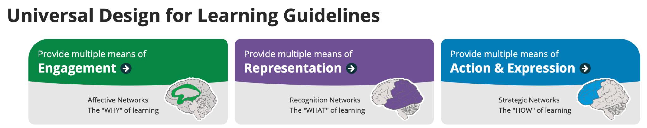
UDL Guidelines
Recruiting Interest
Sustaining Effort & Persistence
Self-Regulation
Perception
Language & Symbols
Comprehension
Physical Action
Expression & Communication
Executive Functions

Slide 29
Outlining UDL
UDL is
UDL is not
A research-backed framework
Aims to give all students equal opportunities to succeed, no matter how they learn
Removing the need for accommodations
A solution for all issues
Reducing expectations of students or less rigorous
A prescriptive formula
Based on learning styles
Source: Sonoma State University Guide to Implementing a Two-hour Workshop

Slide 30
Discussion
What are some ways we can implement UDL in online courses?

Slide 31
Five Strategies for Faculty to Apply UDL (Tobin, 2014)
1
2
3
4
5
Text Foundation
Alternatives
Expression
Chunking
Accessible tools
Record videos using a script and/or outline
Use multiple formats e.g. video + text
Design assessments so students can express knowledge in their own way
Scaffold content into portions (in lectures, videos, webpages)
Integrate user-friendly and free tools

Slide 32





UDL & Syllabi Action Plan
Highlight course goals and why the course material selected is relevant to students
Utilize a variety of course materials
Discuss typical weekly routine and course components
Address specific expectations of students and their responsibilities
Include personal accessibility and inclusion syllabus statement
List a variety of methods to contact instructor
Sources: UDL on Campus, Sonoma State University Faculty Guide

Slide 33
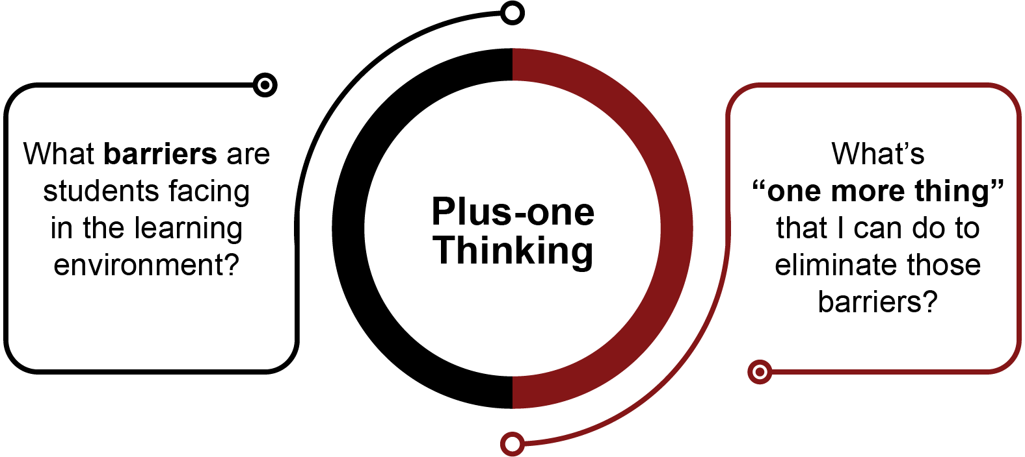
Plus One Thinking & Inclusive Teaching
Integrating accessibility and UDL can be iterative and incremental
Plus One Thinking

Slide 34
Designing Accessible Content on Canvas

Slide 35


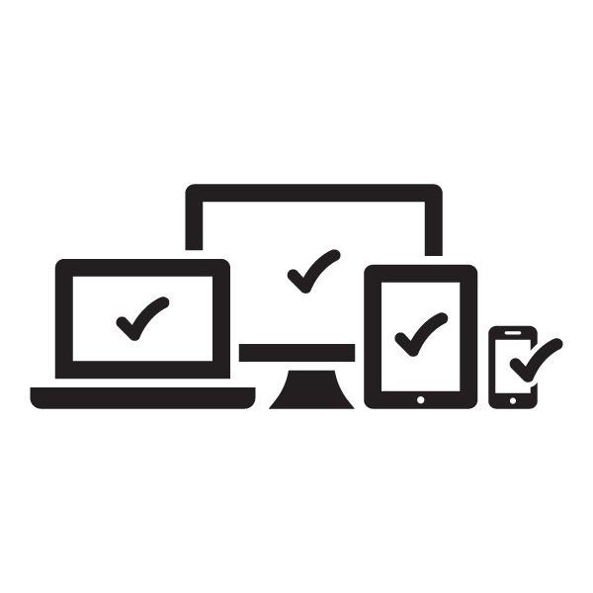

Accessibility Principles
Perceivable
Operable
Understandable
Robust

Slide 36

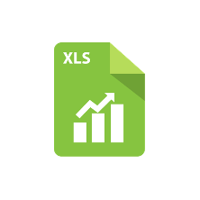
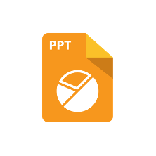

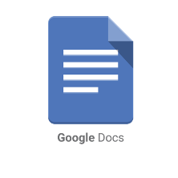
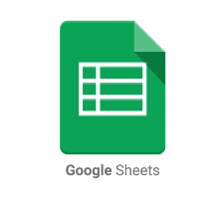
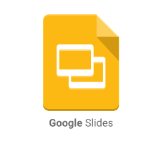
Accessible Documents
All course materials and files must meet accessibility standards
Core accessibility concepts apply to all programs
Microsoft Office products have an Accessibility Checker

Slide 37
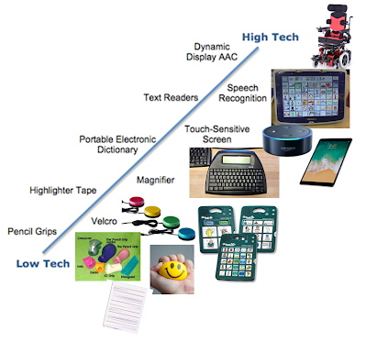
Assistive Technology
Any device, software, or equipment that helps people with disabilities learn, communicate, or function better
Note: Assistive technologies cannot completely overcome inaccessible content
Takeaway: Course design must consider assistive technology usage

Slide 38
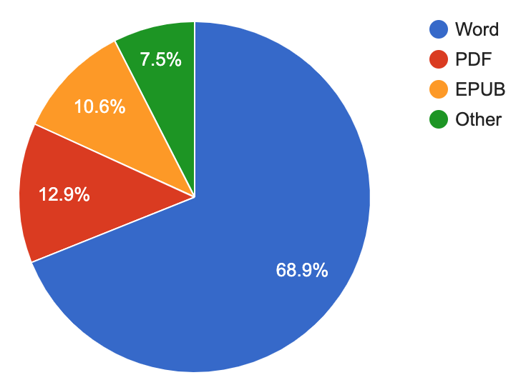
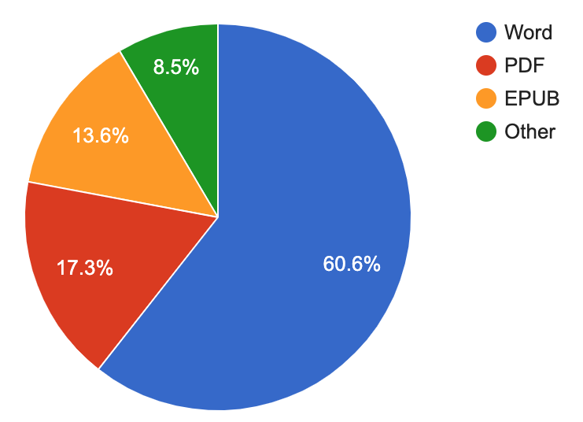
Document Accessibility &
Preferences of Screen Reader Users
Document Accessibility
Document Preferences
Source: WebAIM Survey from May-June 2021 of 1568 participants

Slide 39
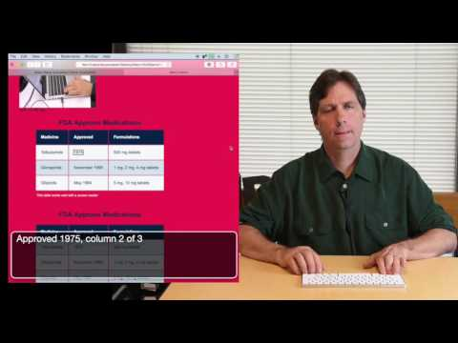

Screen Reader Demo

Slide 40







7 Core Accessibility Skills
Alternative Text
Text equivalent to visuals
Contrast
Considers colorblindness
Minimum color contrast
Headings
Organize materials to navigate
Links
Easily identifiable
Lists
List styles and scannability
Tables
Straightforward
Ensure proper reading order
Multimedia
Accurate video captions

Slide 41

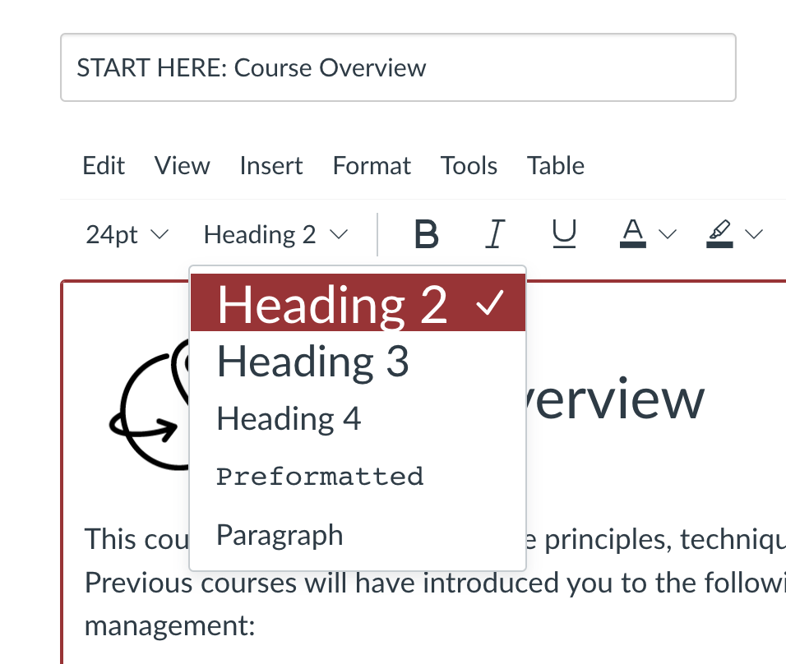
Headings
Use headings to break up content
Format as headings
Do not skip levels
Higher level headings should be larger sizes

Slide 42
Hyperlink Accessibility
Descriptive
Meaningful
Context Independent
Learn more: https://www.youtube.com/watch?v=IGk1HI1NGug
We will examine how evaluating internal control relates to substantive testing. Read more here.
website.
Learn more by watching the drilling and sampling procedures video
Read more about internal control systems.
Code of Ethics

Slide 43
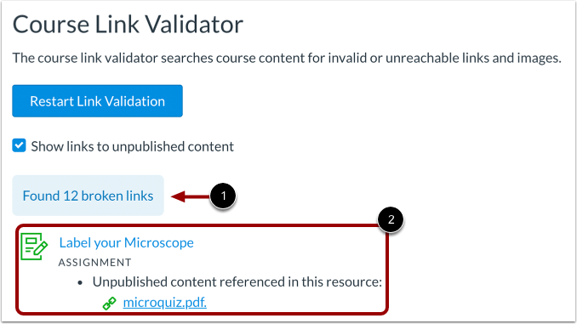
Checking Links
Automate it! Canvas Link Validator
Manual checking
Still recommended periodically
Validator does not find all issues

Slide 44
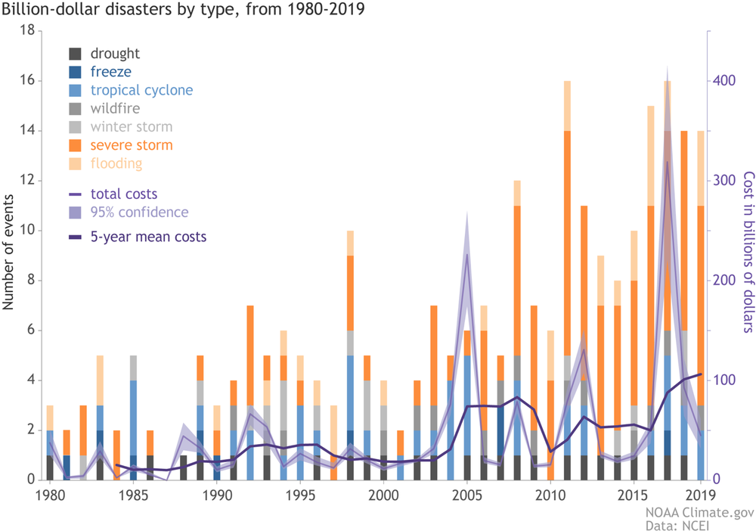
Image Accessibility (Alt Text)
Describes meaning and context of informative images
Alt text not sufficient for complex images (description and/or caption is needed)

Slide 45
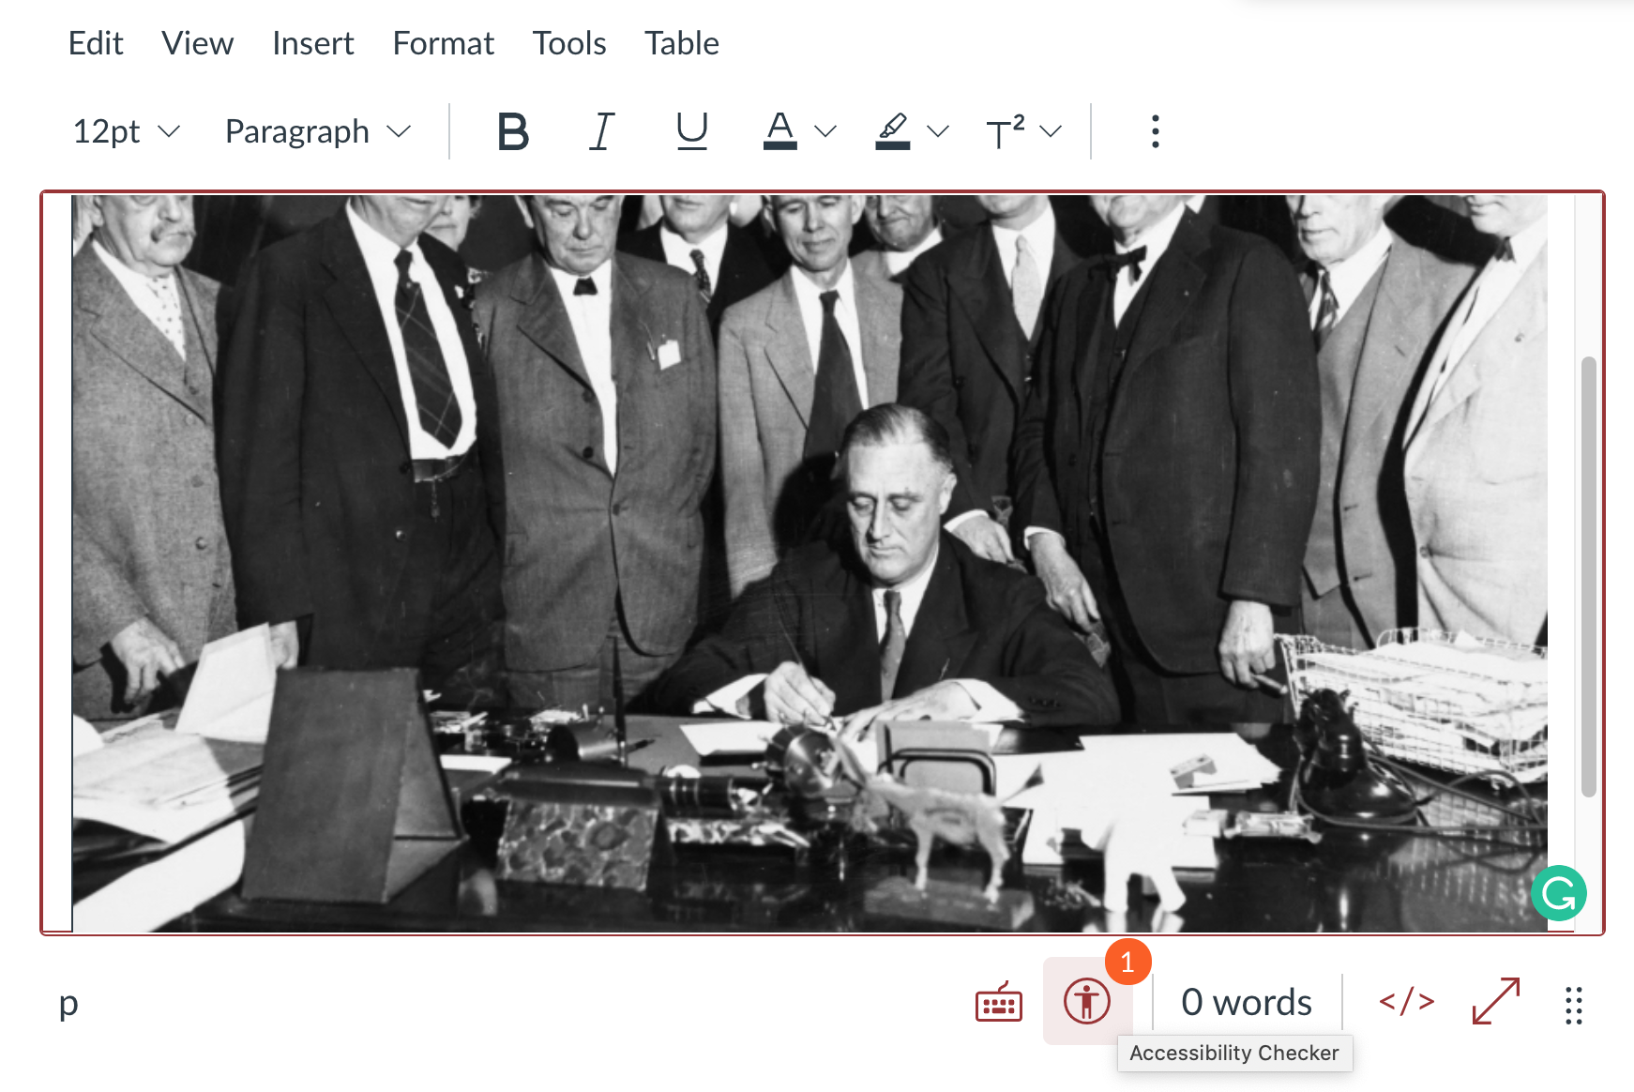
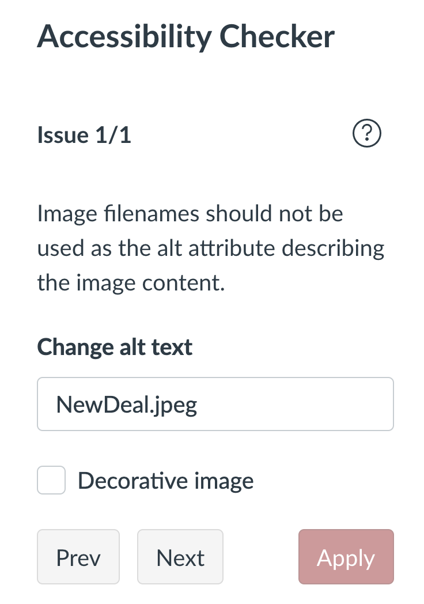
Canvas Accessibility Checker

Slide 46
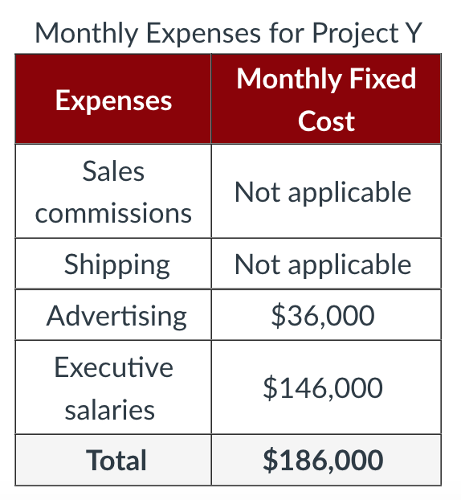
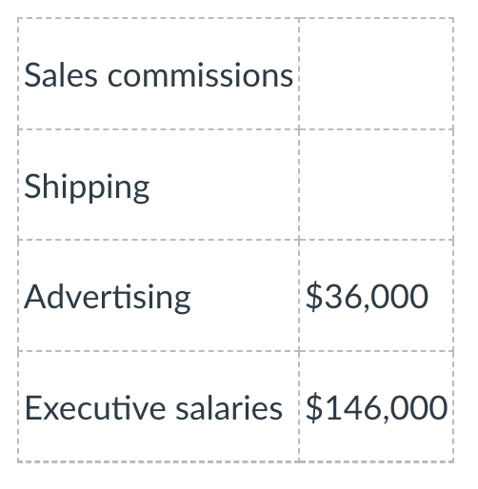
Table Accessibility
Inaccessible table
Accessible table

Slide 47
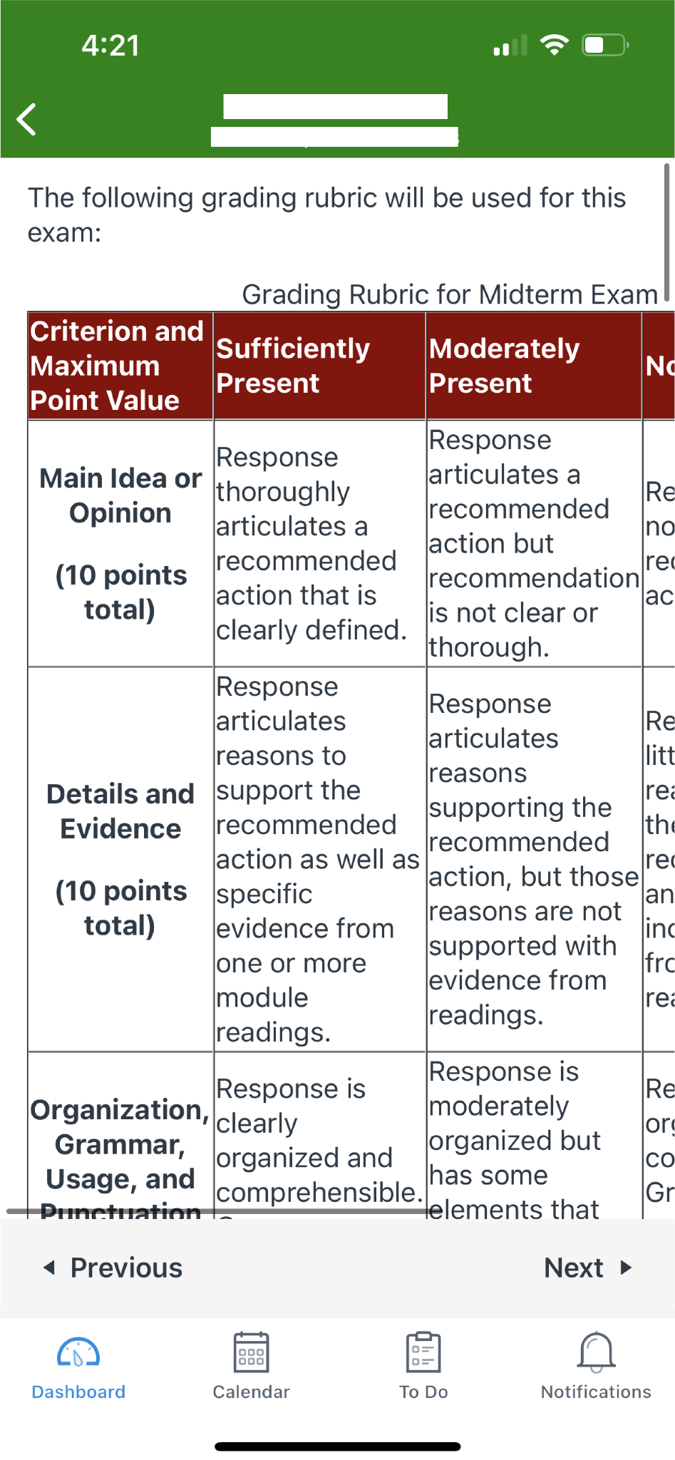
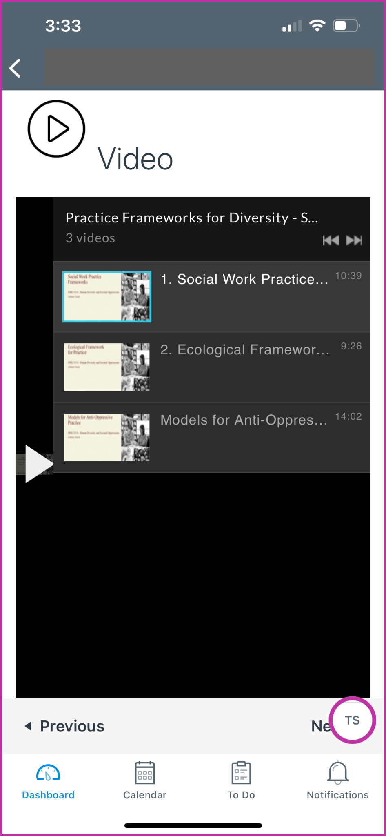
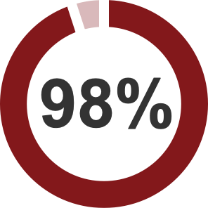
Mobile Compatibility
of students use the Canvas app at least once a week (UCF’s Division of Digital Learning, 2018)
Takeaway
Construct pages with responsive design and consider how content will display on other devices

Slide 48
Multimedia & Web Conferencing

Slide 49

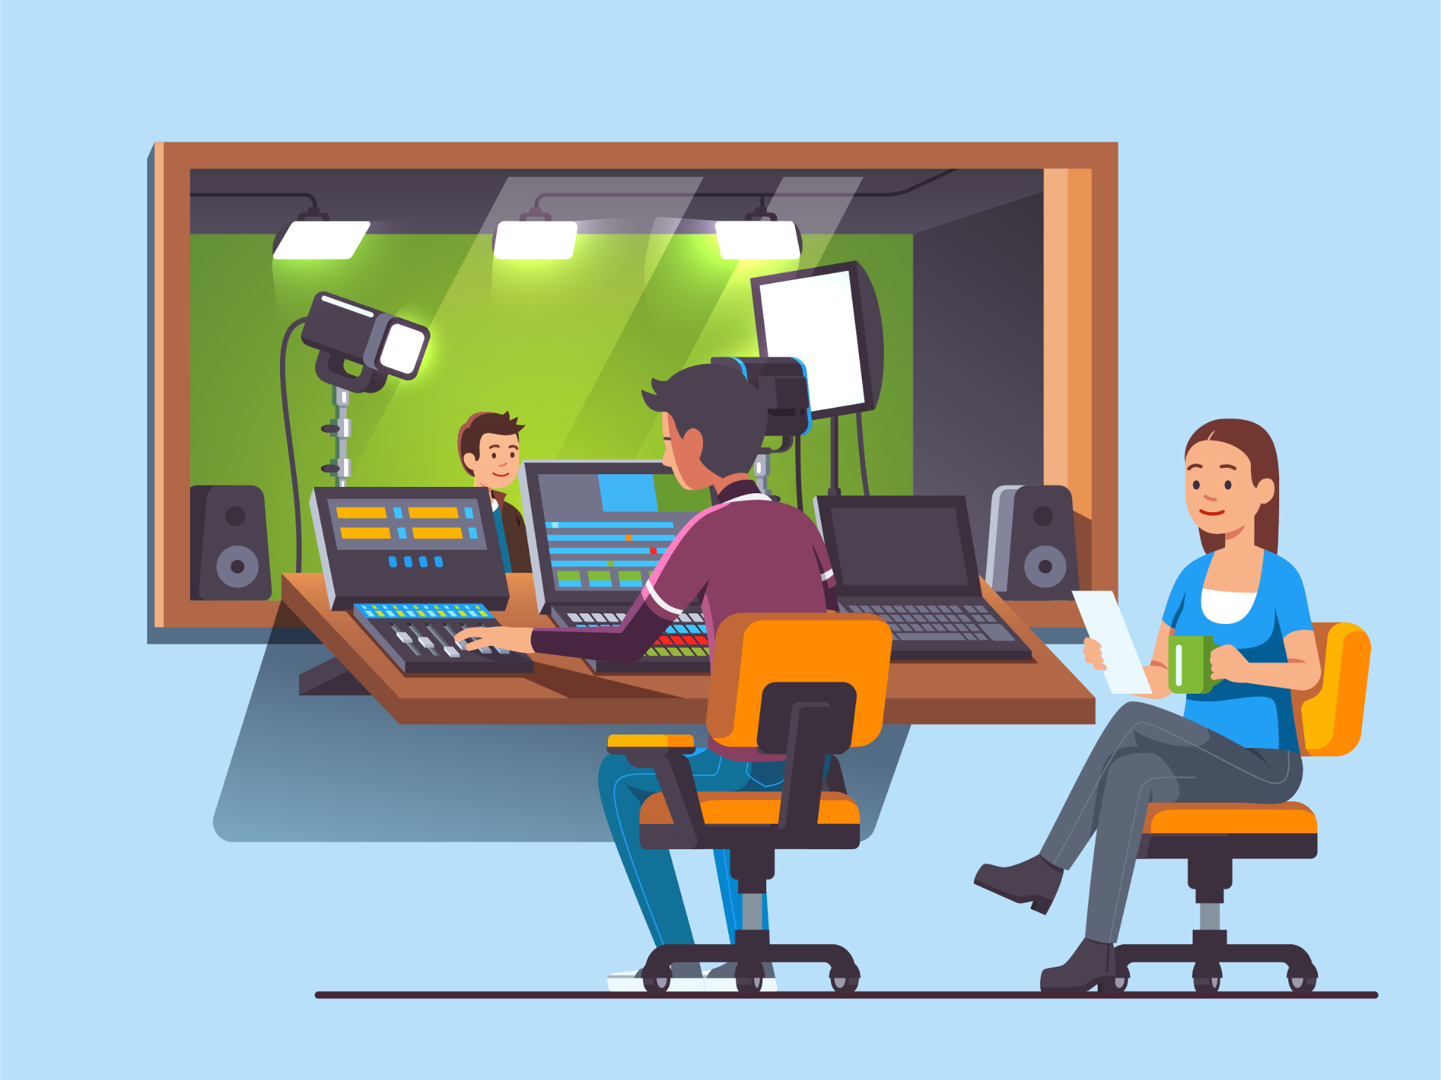
MyMedia
Video player is accessible
Captions
  Editing needed for anything that doesn’t typically go through ODL’s captioning services
  Unedited auto captions will only be 70/80% accuracy (99% is required)

Slide 50

Zoom
Known to be very accessible as a platform
Before
During Live Session
After
Share resources and lecture slides in advance
Customize settings (chat and caption font size)
Describe what you are doing or what is on screen
Reduce background noise and consider sound quality
Share chat content aloud
Ensure all members can participate in polls, provide sufficient time to respond, and verbally announce polls
Share recording of session with transcript/captions
Sources: Yale (n.d.) and Montgomery College (2021)

Slide 51
Resources

Slide 52
Resources
ODL Accessibility & UDL Resources Google Doc
Reviewing Your Course from the Learner's Perspective - ODL Webinar
  Helpful overview to accessibility and UDL-related concepts
OU Accessibility and Disability Resource Center
TeachAccess.org

Slide 53
Presentation References

Slide 54
References: Disability
Bunbury, S. (2019, February 28). Unconscious bias and the medical model: How the social model may hold the key to transformative thinking about disability discrimination. International Journal of Discrimination and the Law, 19(1): 26-47.
Disability and Health Overview (2020). CDC.
Disability & Health U.S. State Profile Data for Oklahoma (Adults 18+ years of age). (2022). CDC.
Kent, M. (2015). Disability and ELearning: Opportunities and Barriers. Disability Studies Quarterly, vol. 35, no. 1.
Mole, H. (2013, January). A US model for inclusion of disabled students in higher education settings: The social model of disability and Universal Design. Widening Participation and Lifelong Learning, 14(3):62-86.
National Center for Education Statistics. (2021). Fast Facts: Students with disabilities.

Slide 55
References: UDL Principles
Cumming, T.M., Rose, M.C. (2021). Exploring universal design for learning as an accessibility tool in higher education: a review of the current literature. Australian Education Researcher.
Nelson, L. L. (2021). Design and Deliver: Planning and Teaching Using Universal Design for Learning. Brookes Publishing; 1st edition.
Universal Design in Education: Principles and Applications. (2021). Washington University DO-IT (Disabilities, Opportunities, Internetworking, and Technology)
UDL Syllabus. (n.d.). UDL on Campus.
UDL-Universe: A Comprehensive Faculty Development Guide: Two-hour UDL Workshop.(2020). Sonoma State University.
What is Universal Design. (n.d.). National Disability Authority (Ireland).

Slide 56
References: UDL Perspectives
Black, R. D., Weinberg, L. A., & Brodwin, M. G. (2015). Universal Design for Learning and Instruction: Perspectives of Students with Disabilities in Higher Education. Exceptionality Education International, Vol. 25, No. 2, pp. 1–26.
Kennette, L. N. and Wilson, N. A. (2019). Universal Design for Learning (UDL): Student and faculty perceptions. Journal of Effective Teaching in Higher Education. Vol. 2 No. 1: Spring issue.
Tobin, T. (2014). Increase Online Student Retention with Universal Design for Learning. Quarterly Review of Distance Education, 15(3), 13.
Westine, C., Oyarzun, B., Ahlgrim-Delzell, L., Casto, A., Okraski, C., Park, G., Person, J. & Steele, L. (2019). Familiarity, Current Use, and Interest in Universal Design for Learning Among Online University Instructors. International Review of Research in Open and Distributed Learning, 20(5), 20–41.

Slide 57
References: UDL & Online Courses
Burgstahler, S. (2017). Equal access: Universal design of distance learning programs. Disabilities, Opportunities, Internetworking, and Technology Center (DO-IT).
Nave Lillian. (2021). “Universal design for learning UDL in online environments: The HOW of learning.” Journal of Developmental Education, vol. 44, no. 3, pp. 34-35.
Nave, Lillian. (2021). "Universal Design for Learning UDL in Online Environments: The WHAT of Learning." Journal of Developmental Education, vol. 44, no. 2, pp. 30-31.
Nave, Lillian. (2020). "Universal Design for Learning UDL in Online Environments: The WHY of Learning." Journal of Developmental Education, vol. 44, no. 1, pp. 30-31.

Slide 58
References: Inclusive Instructional Design
Edyburn, D. L. (2015). Accessible Instructional Design. Emerald Publishing Limited, 2015. ProQuest Ebook Central.
Instructors. (n.d.). AccessibleU, University of Minnesota.
Rao, K. (2021). Inclusive Instructional Design: Applying UDL to Online Learning. The Journal of Applied Instructional Design, 10(1).
Seale, J. (Ed.). (2020). Improving accessible digital practices in higher education: Challenges and new practices for inclusion. Palgrave Pivot, Cham.
Singleton, K., Evmenova, A., Jerome, M. K., & Clark, K. (2019) Integrating UDL strategies into the online course development process: Instructional designers’ perspectives. Online Learning, 23(1), 206-235.

Slide 59
References: Accessibility
Accessibility Reference - Semantic Elements. (2022). OU Libraries Guide.
“The “Curb Cut” Effect: An Accessible Web Benefits All.” (2019). Introduction to Web Accessibility by Ryerson University, The Chang School.
Burgstahler S. (2021). What higher education learned about the accessibility of online opportunities during a pandemic. Journal of Higher Education Theory and Practice. 21(7):160-170.
Kriger, S. (2022). Accessibility Myths. a11ymyths.
Matz, A., Bosak-Schroeder, C. and the CripAntiquity community. (2020). Making Graduate Programs More Accessible.
Myths About Accessibility. (n.d.). Texas A&M Division of Information Technology.
Screen Reader User Survey #9 Results (2021). WebAIM.

Slide 60
References: Technology
Accessibility Best Practices for Zoom Meetings. (n.d.). Yale University ITS Services.
Canvas Tool Accessibility. University of Minnesota Course: Creating Accessible Canvas Courses.
Gernsbacher, M. A. (2015). “Video Captions Benefit Everyone.” Policy insights from the behavioral and brain sciences vol. 2,1: 195-202.
Lewis, Elisa. (2022). 8 Benefits of Video Transcription & Captioning. 3 Play Media.
Stritto and Linder. (2017). A Rising Tide: How Closed Captions Can Benefit All Students. EDUCAUSE.
Video Accessibility. (n.d.). California State University Northridge Universal Design Center.
Zoom Accessibility Best Practices. (n.d.). Montgomery College Universal Design Center.
2018 Canvas Mobile Survey. University of Central Florida Division of Digital Learning.

Slide 61

Q&A

